Slide 1
Data Encryption Standard
Amjad Ali / Sooraj

Slide 2
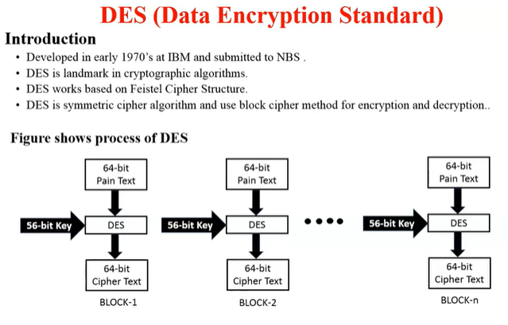

Slide 3
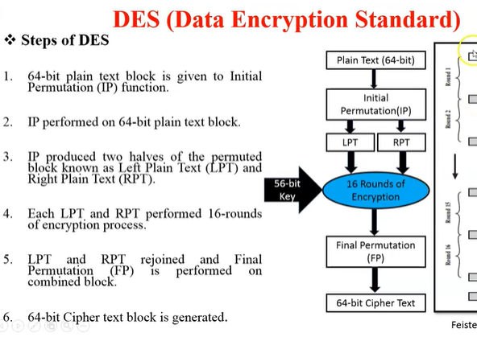

Slide 4
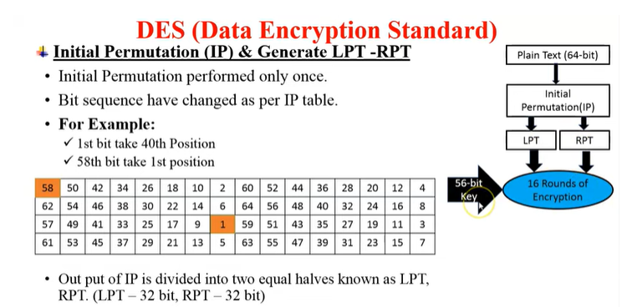

Slide 5
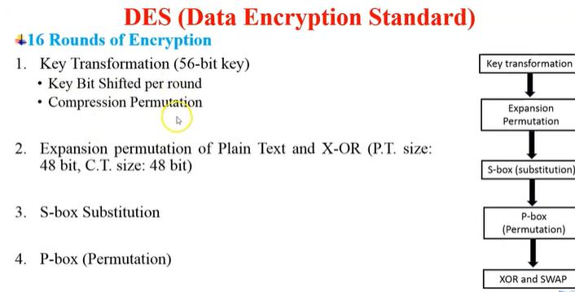

Slide 6
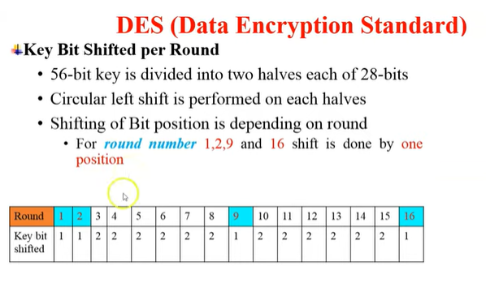

Slide 7
Block cipher
The Data Encryption Standard is a block cipher
Because cryptographic key and algorithm are applied to a block of data simultaneously rather than one bit at a time.

Slide 8
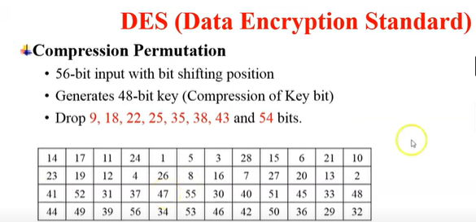

Slide 9
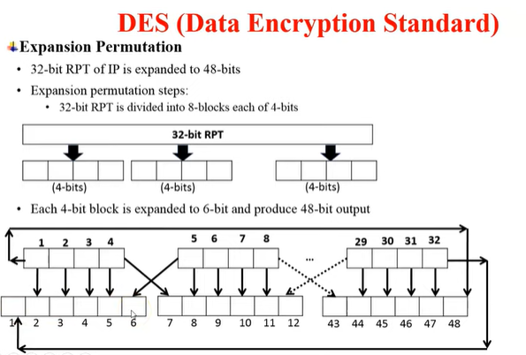

Slide 10
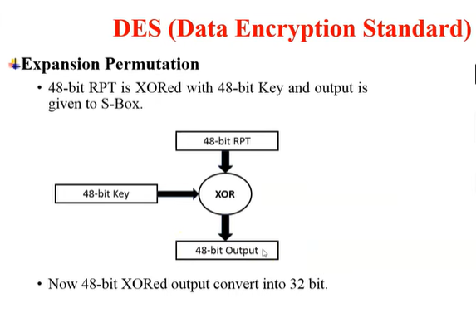

Slide 11
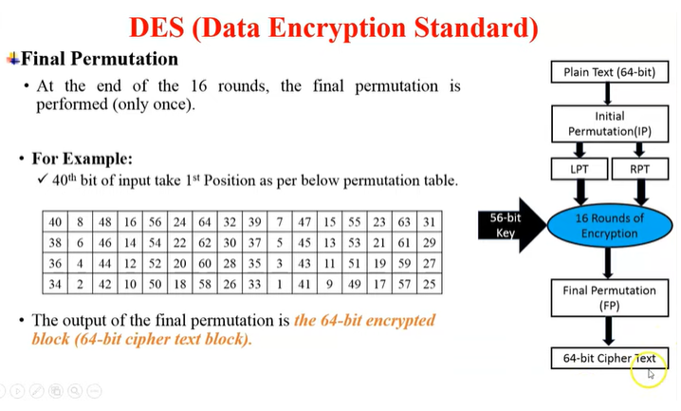

Slide 12
Usage of DES
When approved by USA government :
Used by financial services
Because of its simplicity,
Variety of embedded systems

Slide 13
DES is Unsafe
For any cipher, the most basic method of attack is brute force, which involves trying each key until you find the right one. The length of the key determines the number of possible

